Slide 1


Title: Optimizing Cyberthreat Mitigation Through AI-Enhanced SIEM and Automated Response: A Practical Framework with n8n
BCS786– Project Work
B9
RAJAT PRAKASH DHAL : 1HK22CS115
MD AZIM : 1HK22CS070
NEHAL PRASAD : 1HK22CS098
SANDEEP KUMAR : 1HK22CS133
Under the Guidance of:
Prof. Keerthi V.
Assistant Professor
Department of Computer Science & Engineering, HKBKCE-VTU
Notes:
1

Slide 2
Content
Abstract
Problem Statement
Objectives
Scope
Dataset Details
Literature Survey
System Architecture
Methodology
Module Description
Implementation & Paper published details
Results / Output
Conclusion
Future Enhancements
References
Acknowledgment
Department of Computer Science & Engineering, HKBKCE-VTU
Notes:
2

Slide 3
Abstract
Problem: Manual cybersecurity response is slow and inefficient, and existing SOAR platforms are too expensive and heavy for smaller organizations. My project addresses this gap by using n8n to design lightweight, automated security workflows.
Proposed Solution: The proposed solution is a free, lightweight cybersecurity automation framework using n8n to integrate with open-source tools and APIs, enabling faster, automated incident response without the cost and complexity of traditional SOAR platforms.
Methodology: The methodology involves identifying key cybersecurity tasks, designing workflows in n8n, and integrating free tools/APIs (antivirus logs, threat intelligence, messaging) to automate incident detection and response.
Results: The designed n8n workflows successfully automated tasks like alert notifications, phishing email handling, and threat lookups, demonstrating faster response and reduced manual effort compared to traditional manual methods.
Outcome: The project delivered a cost-effective, lightweight cybersecurity automation framework using n8n, proving that open-source tools can serve as an alternative to expensive SOAR platforms for small organizations or academic use.
Department of Computer Science & Engineering, HKBKCE-VTU
Notes:
3

Slide 4
Problem Statement
Lightweight, Low-Cost and Customizable Cybersecurity Automation Using n8n
The Accessibility Gap: Most advanced SOAR (Security Orchestration, Automation, and Response) solutions are costly and resource-heavy, restricting their use to large enterprises. Smaller organizations, academic institutions, and individuals are left without affordable automation options for cybersecurity.
The Integration Gap: Traditional security tools like antivirus, firewalls, and SIEMs often operate in isolation. This lack of orchestration results in slower response times and reliance on manual intervention, which increases the risk of delayed threat mitigation.
The Flexibility Gap: Enterprise SOAR platforms are rigid and vendor-locked, offering predefined playbooks with limited adaptability. In contrast, many environments require lightweight, customizable workflows that can evolve quickly with changing threats, something current tools fail to provide.
Department of Computer Science & Engineering, HKBKCE-VTU
Notes:
4

Slide 5
Objectives
Design a lightweight cybersecurity automation framework using the open-source tool n8n as an alternative to costly SOAR platforms.
Integrate free/open-source security tools and APIs (e.g., antivirus logs, threat intelligence feeds, email/messaging services) to automate common incident response workflows.
Develop customizable workflows for tasks such as phishing email handling, log monitoring, and automated alert notifications.
Evaluate the framework’s effectiveness in reducing manual effort, improving response time, and enhancing coordination compared to traditional manual methods.
Promote accessibility and inclusivity in cybersecurity by creating a cost-effective, open-source solution suitable for small organizations, academic institutions, and individual users.
Department of Computer Science & Engineering, HKBKCE-VTU
Notes:
5

Slide 6
Scope of the Project
While our models show competitive performance, we acknowledge several important limitations:
Lightweight SOAR Capabilities: Delivers essential automation features such as alert handling, task orchestration, and workflow execution without the heavy overhead of enterprise SOAR systems.
Integrated Workflow Automation: Works seamlessly with external antivirus tools, log sources, and APIs to automate responses, streamline processes, and enhance operational efficiency.
Optimized for Small-Scale Deployments: Ideal for academic projects, personal security labs, and small organizations that need effective automation without large infrastructure requirements.
Department of Computer Science & Engineering, HKBKCE-VTU
Notes:
6

Slide 7
Dataset Details
Source:
Publicly available, free, and open-source tools and APIs integrated via n8n workflows.
Security event logs from antivirus software (e.g., Windows Defender, ClamAV).
Threat intelligence feeds (e.g., AbuseIPDB, VirusTotal free API).
System/Network logs (via syslog, Elastic stack, or OSQuery).
Messaging/Notification platforms (Slack free tier, Telegram, Email).
Coverage & Usage:
Alerts and log entries were used as input data for automated workflows.
Threat intelligence lookups used free API calls for IPs, domains, or file hashes.
Notifications delivered to admin channels through messaging integrations.
Nature of Data:
Primarily structured/semi-structured logs, alerts, and API responses.
Real-world security events simulated at small scale for workflow testing.
Department of Computer Science & Engineering, HKBKCE-VTU
Notes:
7

Slide 8
Dataset Details
Features/Attributes
Input Data Sources:
Antivirus Logs: Alerts and events from free tools (e.g., Windows Defender, ClamAV).
System/Network Logs: Collected via syslog, OSQuery, or Elastic stack.
Threat Intelligence Feeds: API lookups from services like AbuseIPDB, VirusTotal.
User Reports: Phishing email submissions or suspicious activity reports.
Messaging/Notification Platforms: Slack, Telegram, or Email for alerts.
Workflow Attributes:
Automation Tasks: Log monitoring, phishing email analysis, alert forwarding, threat lookup.
Trigger Mechanisms: Event-based (new alert/log), time-based (scheduled scans), or user-based (manual report).
Response Actions: Notifications to admins, threat blocking actions, or API- driven lookups.
Department of Computer Science & Engineering, HKBKCE-VTU
Notes:
8

Slide 9
Literature Survey
Problem: Cybersecurity operations today face an overwhelming reliance on expensive, enterprise-grade SOAR (Security Orchestration, Automation, and Response) platforms, leaving smaller organizations without accessible automation solutions.
Existing Gaps:
Most automation tools (e.g., Splunk SOAR, Cortex XSOAR) are proprietary and resource-intensive, limiting adoption in academic and small-to-medium enterprise contexts.
Open-source SIEM solutions (e.g., ELK stack, Wazuh) provide detection but lack flexible, user-friendly workflow automation.
Existing research largely emphasizes detection accuracy but neglects automated response, triaging, and integration across multiple threat intelligence sources.
Department of Computer Science & Engineering, HKBKCE-VTU
Notes:
9

Slide 10
The n8n Initiative: By leveraging a lightweight, open-source workflow automation platform, this project explores building customizable cybersecurity pipelines that integrate log monitoring, phishing detection, and threat intelligence lookups. This directly addresses the accessibility gap, providing a scalable and adaptable alternative for low-resource environments such as universities, startups, and small security teams.
Key Technical Approaches & Our Position
Dominant Methods: In workflow automation and integration tasks, existing approaches focus on:
Pre-built Connectors: Using ready-made nodes for popular apps and services to simplify automation.
Custom Scripting & API Integration: Writing scripts or using API calls to handle edge cases not supported by standard nodes.
Orchestration Platforms: Leveraging platforms like Zapier, Make, or n8n for no-code/low-code workflow orchestration.

Slide 11
Literature Survey
Identified Challenge: Many SOAR automation solutions face scalability and flexibility issues, particularly when handling complex, multi-step workflows that span numerous services or require custom logic.
Our Contribution: Our work builds on this by designing a custom n8n workflow system that integrates multiple services efficiently, supports dynamic conditional logic, and can be easily extended. This approach provides robust, scalable, and flexible automation while minimizing manual intervention, effectively streamlining complex tasks across platforms.
Department of Computer Science & Engineering, HKBKCE-VTU
Notes:
11

Slide 12
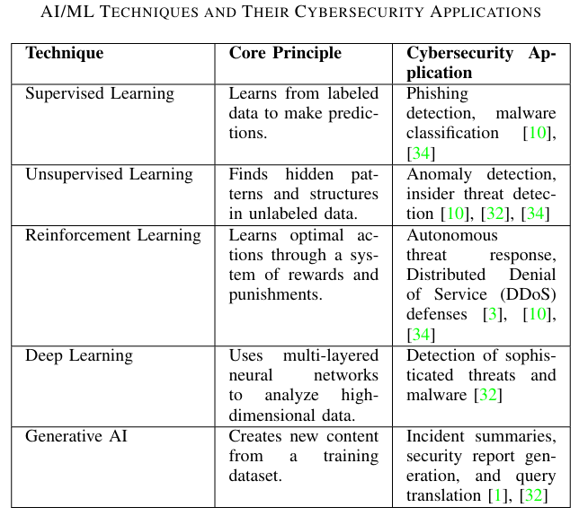
ENHANCING THE SIEM LIFE CYCLE WITH AI

Slide 13
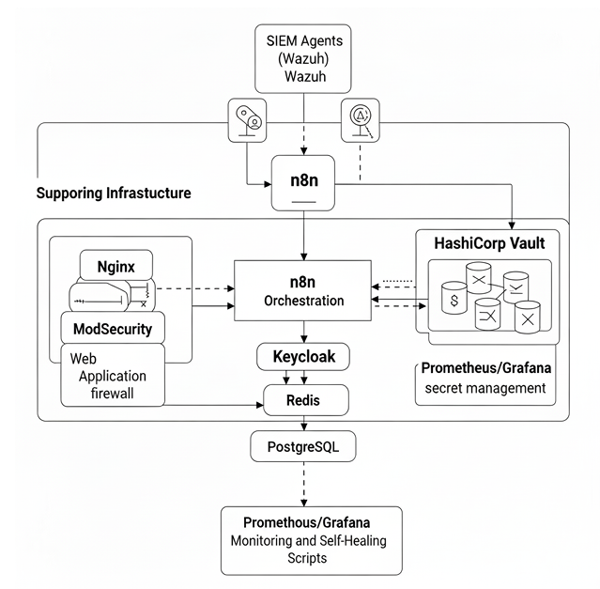
System Architecture
THE N8N FRAMEWORK FOR AUTOMATED ACTION AND RESPONSE
Department of Computer Science & Engineering, HKBKCE-VTU
Notes:
13

Slide 14
Methodology
Technologies Used:
n8n (workflow automation platform) for orchestrating cyberthreat intelligence pipelines
Python 3.8+ scripts for custom enrichment, parsing, and analytics
APIs & Integrations: VirusTotal, Shodan, AlienVault OTX, AbuseIPDB, WHOIS
Database: MongoDB / PostgreSQL (for storing threat intelligence records)
Deployment: Docker for containerized workflow execution
Algorithms & Techniques:
Rule-based enrichment for IPs, domains, and file hashes
Correlation & deduplication logic to reduce noise from multiple feeds
Risk scoring heuristics (based on threat feed confidence levels, frequency, and context)
Event-driven triggers (webhooks, cron jobs, SIEM alerts) for real-time automation
Department of Computer Science & Engineering, HKBKCE-VTU
Notes:
14

Slide 15
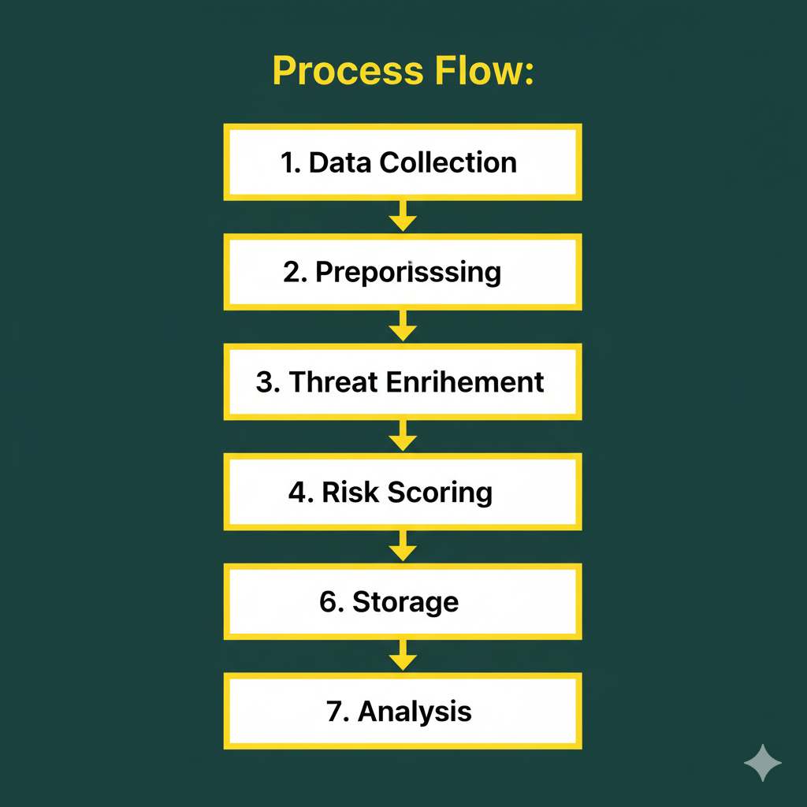
Process Flow:
Data Collection → Ingest IoCs (Indicators of Compromise) from OSINT & paid threat feeds
Preprocessing → Normalize formats (IP, domain, hash) and remove duplicates
Threat Enrichment → Cross-check against VirusTotal, AbuseIPDB, Shodan, OTX, WHOIS
Risk Scoring → Apply heuristics to prioritize high-confidence threats
Storage → Save enriched indicators in MongoDB/Postgres for querying & auditing
Alerting → Send alerts via Slack, Email, or forward to SIEM/SOAR tools
Analysis → Monitor pipeline efficiency, false positive rates, and feed reliability

Slide 16
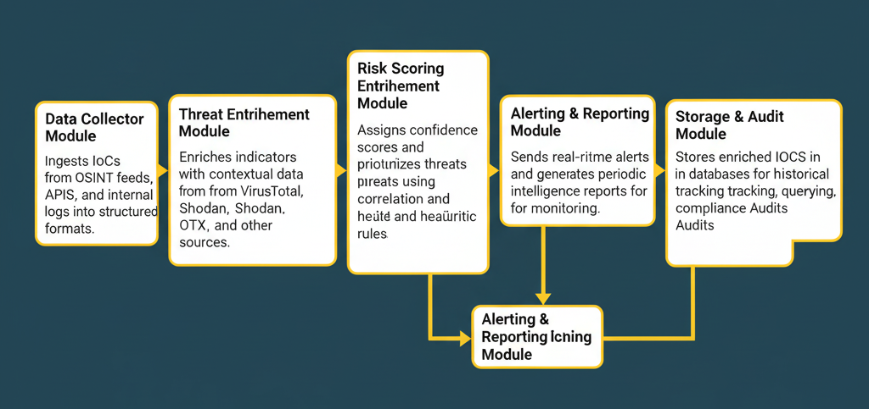
Module Description
Department of Computer Science & Engineering, HKBKCE-VTU
Notes:
16

Slide 17
Paper Published details
17
Title: Team Optimizing Cyberthreat Mitigation Through AI-Enhanced SIEM and Automated Response: A Practical Framework with n8n
Authors: Rajat Prakash Dhal, Md Azim, Nehal Prasad, Sandeep Kumar, Prof. Keerthi V.
Journal / Conference Proceedings:
Proceedings of 2025 IEEE Pune Section International Conference (IEEE PuneCon 2025)
Publisher: IEEE Pune Section
ISBN/ISSN:
Not Yet Published-
Indexing Status:
Not Yet Indexed-

Slide 18
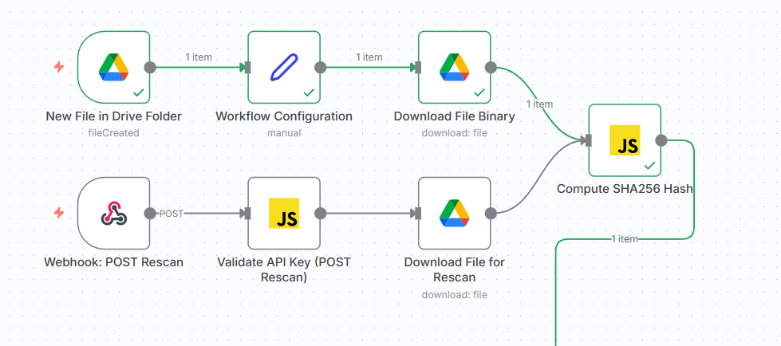
Implementation
Department of Computer Science & Engineering, HKBKCE-VTU

Slide 19
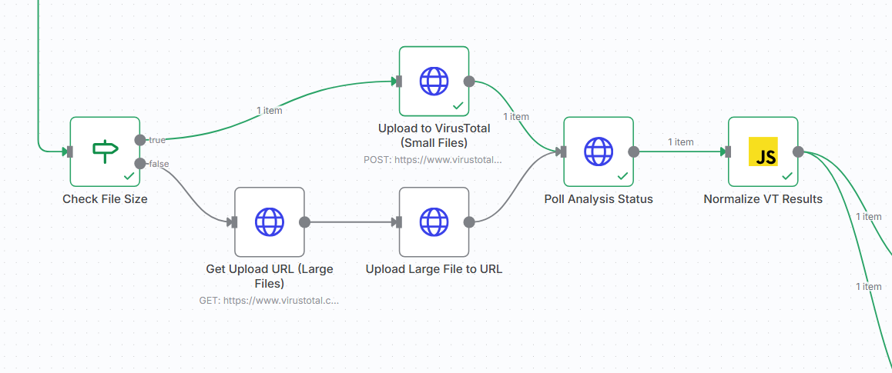
Implementation
Department of Computer Science & Engineering, HKBKCE-VTU

Slide 20
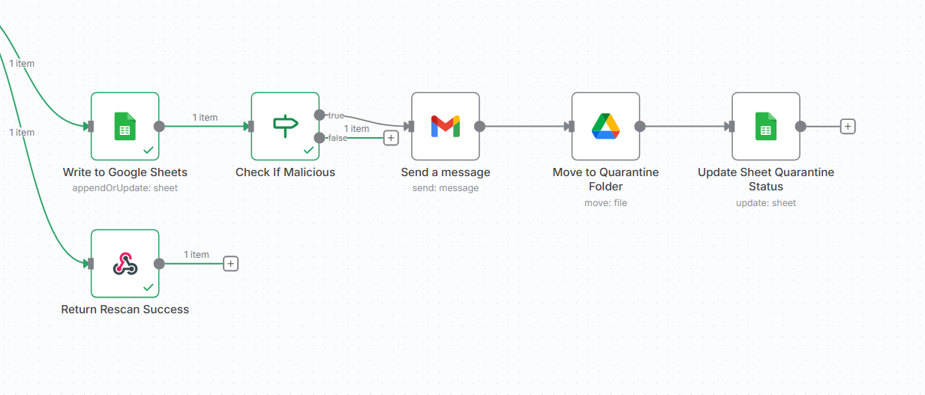
Implementation
Department of Computer Science & Engineering, HKBKCE-VTU

Slide 21
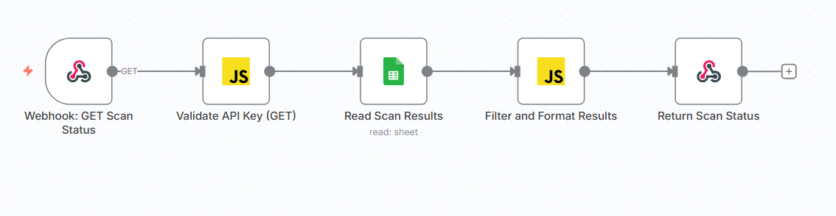
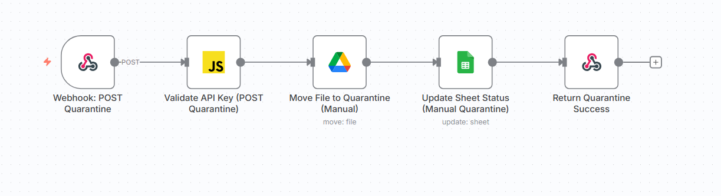
Implementation
Department of Computer Science & Engineering, HKBKCE-VTU

Slide 22
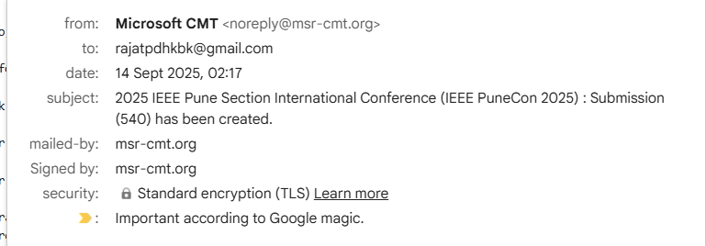
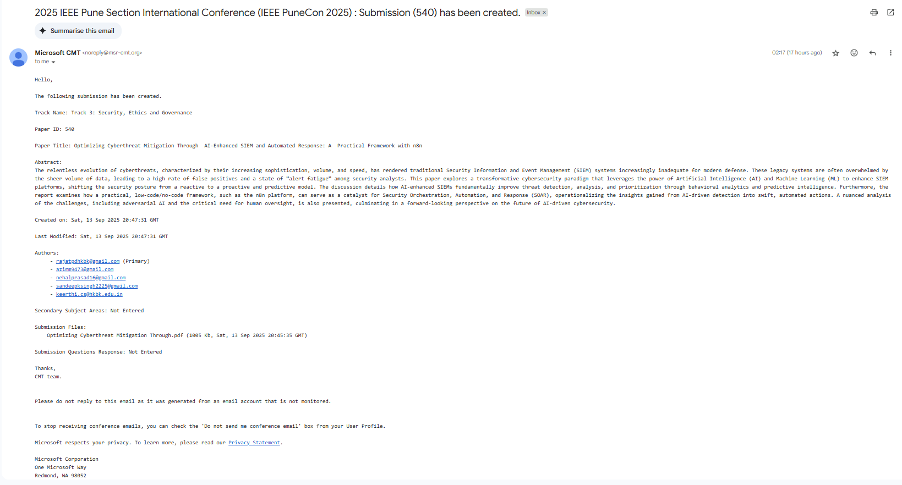
Proof of Submission/Acceptance/Publication
22

Slide 23
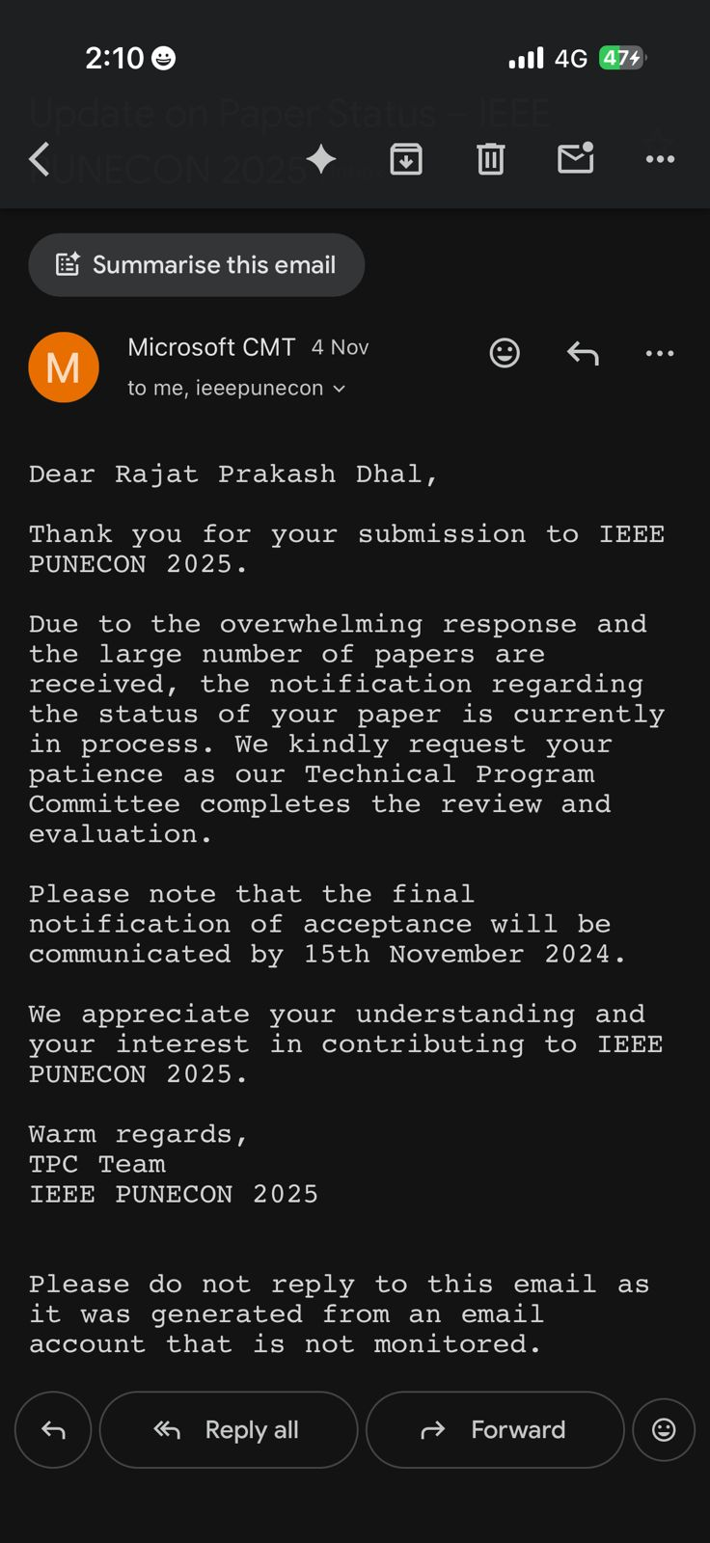
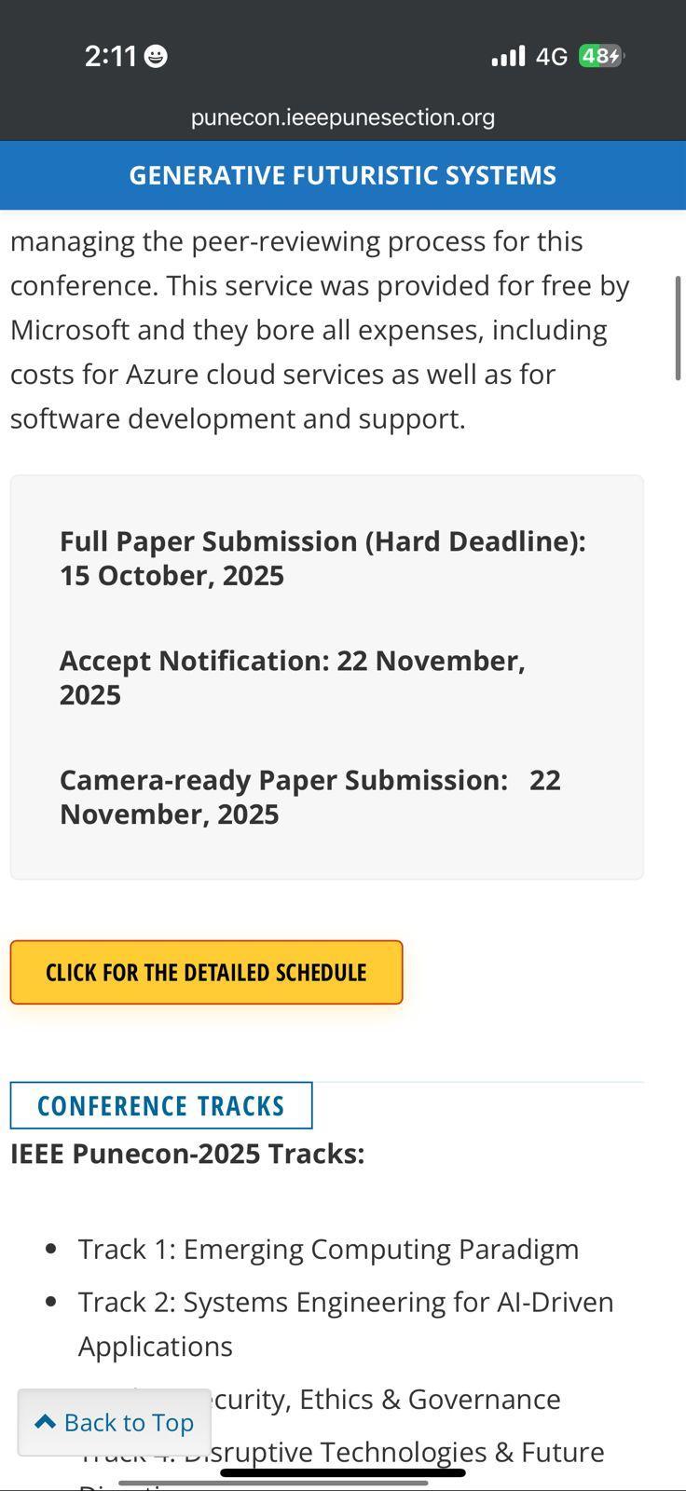
Proof of Submission/Acceptance/Publication
23

Slide 24
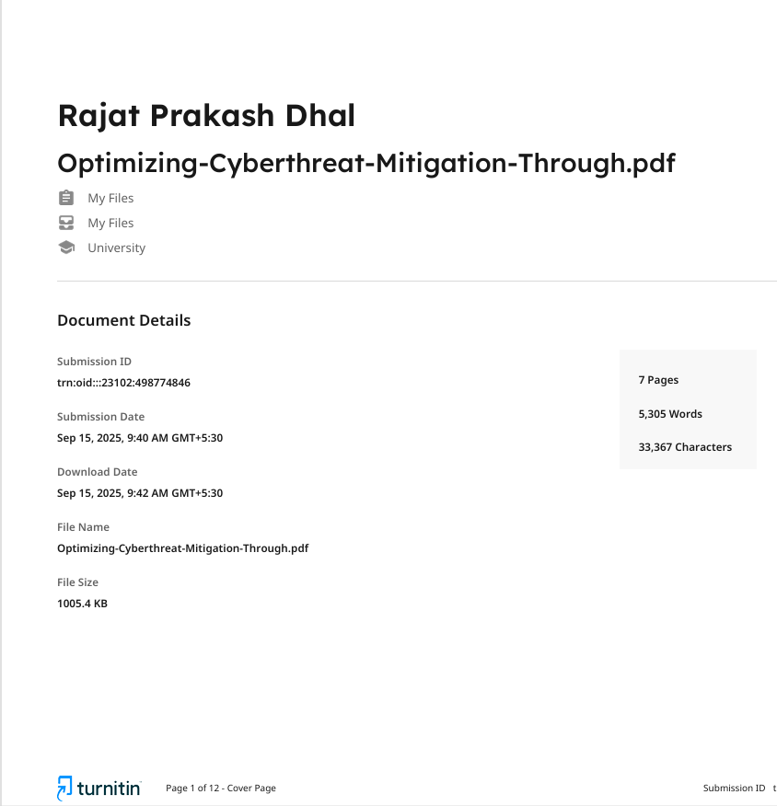
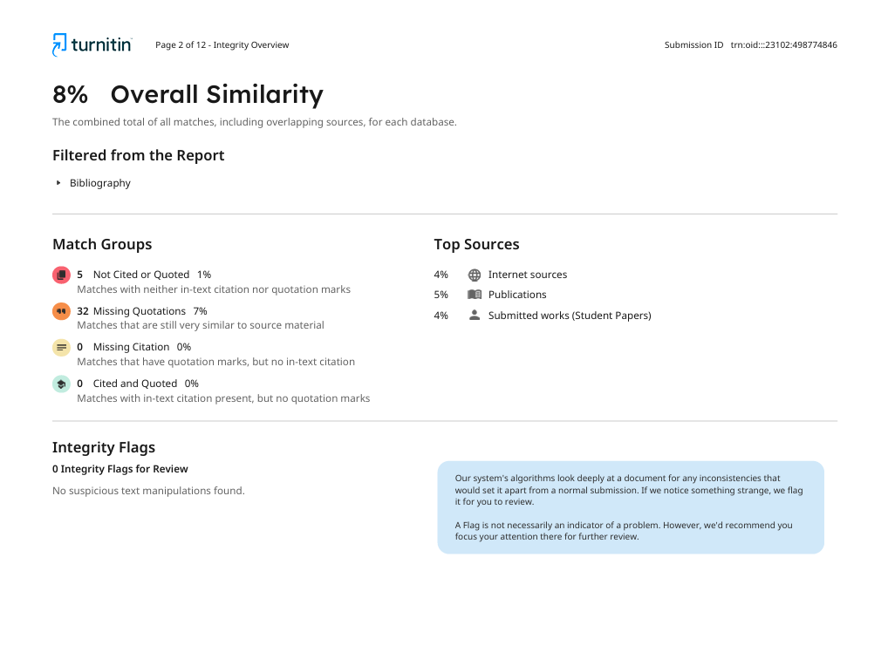
Plagiarism Report
24
Plagiarism Percentage: 8% Tool Used: Turnitin

Slide 25
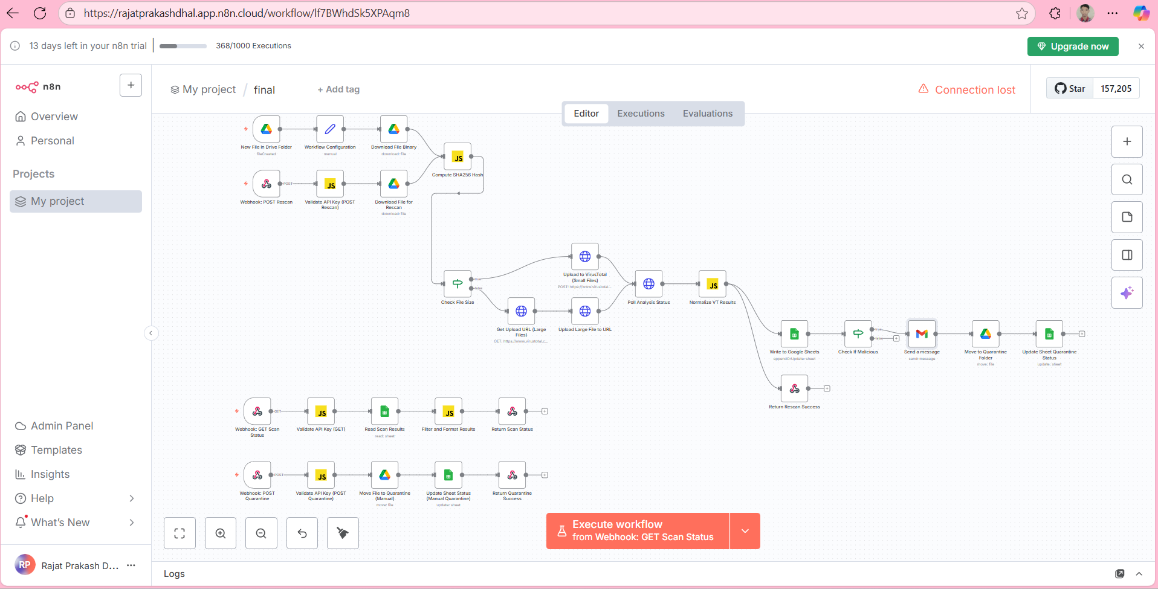
Demo
Workflow

Slide 26
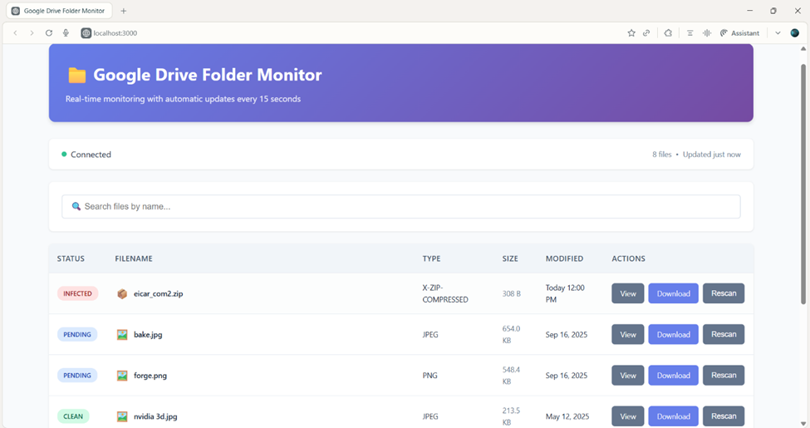
Results / Output
User Interface
Department of Computer Science & Engineering, HKBKCE-VTU

Slide 27
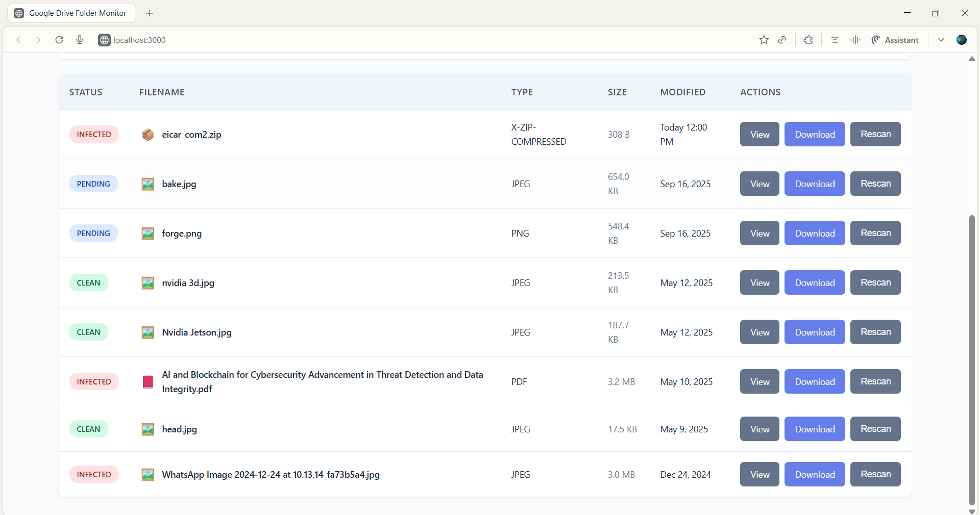
Results / Output
Testing different Infected files(jpg, pdf, zip)
Department of Computer Science & Engineering, HKBKCE-VTU

Slide 28
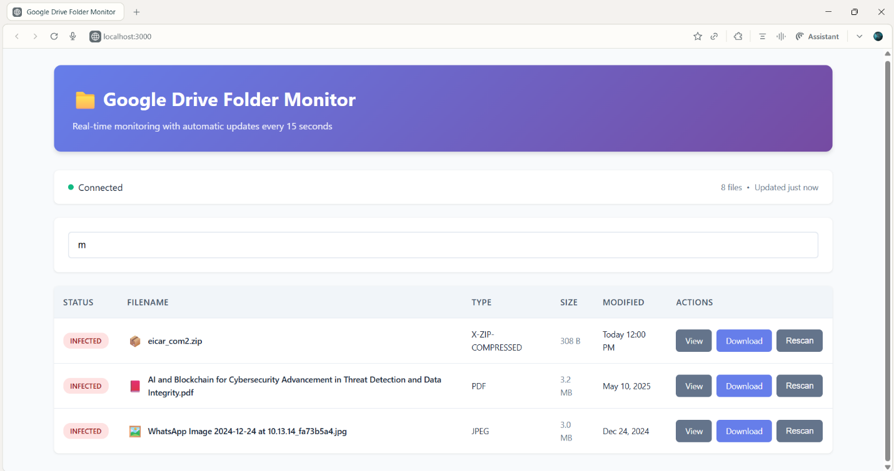
Results / Output
Filter feature
Department of Computer Science & Engineering, HKBKCE-VTU

Slide 29
Conclusion
Key Achievements:
Built an automated cyberthreat intelligence workflow in n8n integrating multiple threat feeds and APIs.
Successfully implemented real-time alerting and enrichment, enabling faster incident response.
Designed modular pipelines that allow scalability and easy integration with existing security infrastructure (e.g., SIEM, SOC tools).
What Worked Well:
n8n’s low-code automation streamlined the creation of complex workflows with minimal overhead.
API integrations (threat intelligence platforms, malware databases, and OSINT sources) provided enriched and contextualized threat data.
Event-driven triggers ensured timely detection and response, reducing manual effort in monitoring.
Department of Computer Science & Engineering, HKBKCE-VTU

Slide 30
Conclusion
Key Limitations:
Data quality inconsistencies from external threat feeds occasionally introduced noise and false positives.
Resource constraints limited large-scale testing with high-volume, real-world attack simulations.
Lack of advanced AI-based detection meant reliance on rule-based and feed-based intelligence, which may miss novel threats.

Slide 31
Future Enhancements
Performance Improvements:
Optimized API Calls - Implement more efficient polling and data fetching methods to reduce API call volume and improve the speed of security event processing.
Distributed Processing - Design workflows that can be run on multiple n8n instances to handle a high volume of security events without performance degradation.
Event Filtering and Deduplication - focus only on high-priority incidents.
Technical Enhancements:
Machine Learning for Anomaly Detection - Integrate ML models to detect unusual network traffic or user behavior that may indicate a security breach.
Custom Node Development - Create custom n8n nodes for specialized cybersecurity tools and services not natively supported.
Department of Computer Science & Engineering, HKBKCE-VTU

Slide 32
Future Enhancements
New Features:
Automated Remediation Workflows - Develop workflows that automatically take action on confirmed threats, such as blocking malicious IP addresses on a firewall or disabling compromised user accounts in a directory service.
Compliance and Reporting Dashboards - Build dynamic dashboards to track compliance with security policies and generate automated reports for auditing and regulatory purposes.

Slide 33
References
[1] S. Manikanta, ”AI and Automation in Cybersecurity: Future Skilling for Efficient Defense,” ISACA J., 2024.
[2] Simplilearn, ”20 Emerging Cybersecurity Trends to Watch Out in 2025,” Simplilearn, 2025.
[3] Comparitech, ”Machine Learning for Threat Detection: How It Works,” Comparitech, 2025.
[4] n8n Team, ”Automated URL Phishing Threat Analysis with NixGuard AI,” n8n, 2025.
[5] Anomali, ”The Evolution and Future of SIEM: Integrating Advanced Analytics and AI for Enhanced Cybersecurity,” Anomali, 2025.
[6] Seceon, ”Comparing SIEM Solutions: Advanced Security Analytics Platforms,” Seceon, 2025.
[7] Seceon, ”Automated Threat Hunting,” Seceon, 2025.
[8] n8n Team, ”Low-code Automation for SecOps,” n8n, 2025.
[9] n8n Team, ”Chat Trigger Integrations,” n8n, 2025.
[10] A. Tariq, ”Automate Security Incident Response with Google Sheets, Email Alerts and EDR Isolation,” n8n, 2025.
Department of Computer Science & Engineering, HKBKCE-VTU

Slide 34
Acknowledgment
We would like to express our sincere gratitude to our guide Prof. Keerthi V. for her continuous support and encouragement throughout our project work. We are deeply indebted to Dr. Smitha Kurian, HOD, Computer Science and Engineering for the encouragement provided in the successful completion of the project. We would also like to thank VTU for providing us the opportunity to work on this project.
Department of Computer Science & Engineering, HKBKCE-VTU

Slide 35
THANK YOU
Department of Computer Science & Engineering, HKBKCE-VTU

